Slide 1
Introduction to Linux
Operating System with small foot print

Slide 2
Linux Overview
What is Linux
Unix-like computer operating system assembled under the model of free and open-source software development and distribution.
These operating systems share the Linux kernel.
Typically have the GNU utilities
Comes in several “distributions” to serve different purposes.

Slide 3
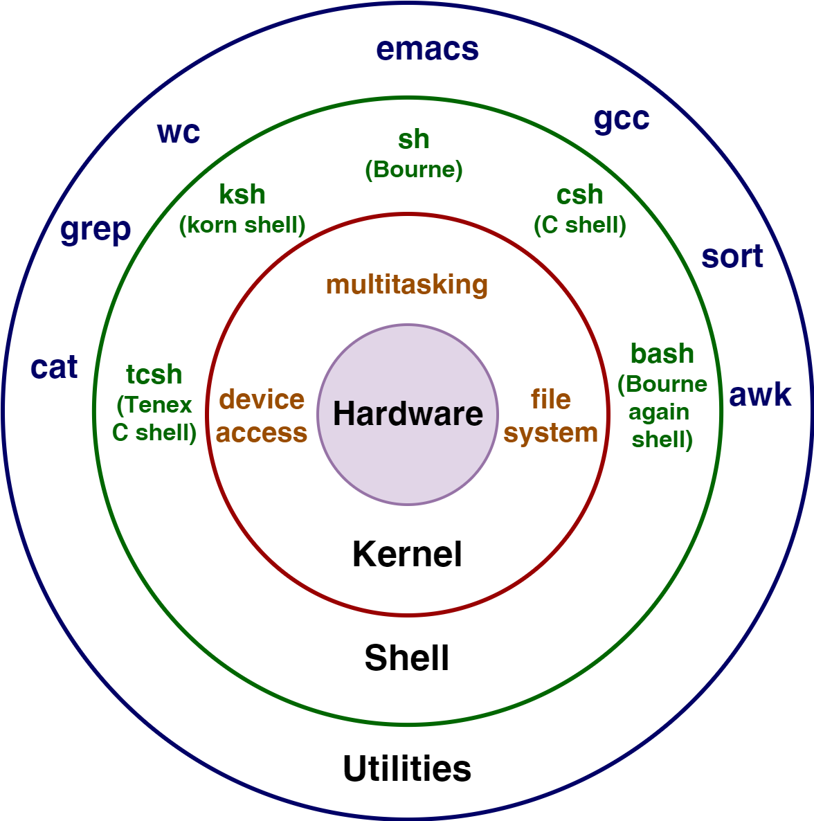
Linux Birds eye view

Slide 4


Who is Linux
Linux is an O/S core originally written by Linus Torvalds. Now almost 10,000 developers including major technology companies like Intel and IBM
A set of programs written by Richard Stallman and others. They are the GNU utilities

Slide 5
Use of Linux
World Wide Web
67% of the world’s web-servers run Linux (2016)
Research/High-Performance Compute
Google, Amazon, NSA, 100% of TOP500 Super-computers.
Modern Smartphones and devices
The Android phone
Amazon Kindle
Smart TVs/Devices

Slide 6
Why Linux
Free and open-source.
Powerful for research datacenters
Personal for desktops and phones
Community (and business) driven

Slide 7
Linux – Command Basics
Command: Command/program that does one thing
Options: Change the way a command does that one thing
Short form: Single-dash and one letter e.g. ls -a
Long form: Double-dash and a word e.g. ls --all
Argument: Provides the input/output that the command interacts with.

Slide 8
Commands: Hands-On
After you connect, type
whoami # my login
hostname # name of this computer
echo “Hello, world” # print characters to screen
echo $HOME # print environment variable
echo my login is $(whoami) # replace $(xx) with program output
date # print current time/date
cal # print this month’s calendar
shazam # bad command

Slide 9
Commands: Selected Text Processing Utilities
cat Display file(s)
cut Extract selected fields of each line of a file
diff Compare two files
grep Search text for a pattern
head Display the first part of files
less Display files on a page-by-page basis
sed Stream editor (esp. search and replace)
sort Sort text files
split Split files
tail Display the last part of a file
tr Translate/delete characters
uniq Filter out repeated lines in a file
wc Line, word and character count

Slide 10
Command History & Command Line Editing
Try the history command
Choose from the command history using the up ↑ and down ↓ arrows
To redo your last command, try !!
To go further back in the command history try !, then the number as shown by history (e.g., !132). Or, !ls, for example, to match the most recent ‘ls’ command.
What do the left ← and right → arrow do on the command line?
Try the <Del> and <Backspace> keys

Slide 11
Help with Commands
Type
date –-help
man date
info date
BASH built-ins
A little different from other commands
Just type the command ‘help’
Or ‘man bash’

Slide 12
On Using Man with less
The man command outputs to a pager called less, which supports many ways of scrolling through text:
Space, f # page forward
b # page backward
< # go to first line of file
> # go to last line of file
/ # search forward (n to repeat)
? # search backward (N to repeat)
h # display help
q # quit help

Slide 13
I/O Redirection with Pipes
Many Linux commands print to “standard output”, which defaults to the terminal screen. The ‘|’ (pipe) character can be used to divert or “redirect” output to another program or filter.
w # show who’s logged on
w | less # pipe into the ‘less’ pager
w | grep ‘tuta’ # pipe into grep, print lines containing ‘tuta’
w | grep –v ‘tuta’ # print only lines not containing ‘tuta’
w | grep ‘tuta’ | sed s/tuta/scholar/g # replace all ‘tuta’ with ‘scholar’

Slide 14
Linux File System
The structure resembles an upside-down tree
Directories (a.k.a. folders) are collections of files and other directories.
Every directory has a parent except for the root directory.
Many directories have subdirectories

Slide 15
Navigating the File System
Essential navigation commands:
pwd print current directory
ls list files
cd change directory

Slide 16
Navigating the File System
We use pathnames to refer to files and directories in the Linux file system.
There are two types of pathnames:
Absolute – The full path to a directory or file; begins with /
Relative – A partial path that is relative to the current working directory;
does not begin with /

Slide 17
Navigating the File system
Special characters interpreted by the shell for filename expansion:
~ your home directory (e.g., /usr1/tutorial/tuta1)
. current directory
.. parent directory
* wildcard matching any filename
? wildcard matching any character
TAB try to complete (partially typed) filename

Slide 18
Navigating the File System
Examples:
cd /usr/local Change directory to /usr/local/lib
cd ~ Change to home directory (could just type ‘cd’)
pwd Print working (current) directory
cd .. Change directory to the “parent” directory
cd / Change directory to the “root”
ls –d pro* Listing of only the directories starting with “pro”

Slide 19
The ls Command
Useful options for the “ls” command:
ls -a List all files, including hidden files beginning with a “.”
ls -ld * List details about a directory and not its contents
ls -F Put an indicator character at the end of each name
ls –l Simple long listing
ls –lR Recursive long listing
ls –lh Give human readable file sizes
ls –lS Sort files by file size
ls –lt Sort files by modification time (very useful!)

Slide 20
Some Useful Commands
cp [file1] [file2] copy file
mkdir [name] make directory
rmdir [name] remove (empty) directory
mv [file] [destination] move/rename file
rm [file] remove (-r for recursive)
file [file] identify file type
less [file] page through file
head -n N [file] display first N lines
tail -n N [file] display last N lines
ln –s [file] [new] create symbolic link
cat [file] [file2…] display file(s)
tac [file] [file2…] display file in reverse order
touch [file] update modification time
od [file] display file contents, esp. binary

Slide 21
Manipulating File and Directories
Examples:
cd # The same as cd ~
mkdir test
cd test
echo ‘Hello everyone’ > myfile.txt
echo ‘Goodbye all’ >> myfile.txt
less myfile.txt
mkdir subdir1/subdir2 # Fails. Why?
mkdir -p subdir1/subdir2 # Succeeds
mv myfile.txt subdir1/subdir2
cd ..
rmdir test # Fails. Why?
rm –rf test # Succeeds

Slide 22
Symbolic Links
Sometimes it is helpful to be able to access a file from multiple locations within the hierarchy. On a Windows system, we might create a “shortcut.” On a Linux system, we can create a symbolic link:
mkdir foo # make foo directory
touch foo/bar # create empty file
ln –s foo/bar . # create link in current dir.

Slide 23
Find a Needle in a haystack
The find command has a rather unfriendly syntax, but can be exceedingly helpful for locating files in heavily nested directories.
Examples:
find ~ -name bu –type d # search for “bu” directories in ~
find . –name my-file.txt # search for my-file.txt in .
find ~ -name ‘*.txt’ # search for “*.txt” in ~

